Slide 1

4 on 4
Phase 4 Update for Palomar Amateur Radio Club
November 4, 2015
Notes:
This template can be used as a starter file to give updates for project milestones.
Sections
Sections can help to organize your slides or facilitate collaboration between multiple authors. On the Home tab, under Slides, click Section, and then click Add Section.
Notes
Use the Notes pane for delivery notes or to provide additional details for the audience. You can see these notes in Presenter View during your presentation.
Keep in mind the font size (important for accessibility, visibility, videotaping, and online production)
Coordinated colors
Pay particular attention to the graphs, charts, and text boxes.
Consider that attendees will print in black and white or grayscale. Run a test print to make sure your colors work when printed in pure black and white and grayscale.
Graphics, tables, and graphs
Keep it simple: If possible, use consistent, non-distracting styles and colors.
Label all graphs and tables.

Slide 2



Phase 4
A digital microwave geosynchronous amateur radio satellite service system made possible by a partnership between Virginia Tech, AMSAT, and Millennium Space Systems.
Notes:
What is the project about?
Define the goal of this project
Is it similar to projects in the past or is it a new effort?
Define the scope of this project
Is it an independent project or is it related to other projects?
* Note that this slide is not necessary for weekly status meetings

Slide 3
The AMSAT Phase System Explained
Phase 1
Phase 2
Phase 3
Phase 4
Phase 5
battery-powered only, short-lived, technology test-bed
LEO with comms and solar panels
Elliptical orbit, with telemetry and control
GEO!
Lunar or planetary
Ascent Project
Phase 4 Project

Slide 4
Phase 4 – Not Just a Satellite Project
Satellite Service
Terrestrial Service
This mission (Phase 4b) is expected to last at least a year, but possibly four, before the satellite is placed in a parking orbit. This means that satellite service will be for a limited time on this mission. We are hoping to leverage this successful mission into having our own geosynchronous satellite(s) with longer missions. Phase 4a is a AMSAT-DN project.
Using the launch as a motivator, we will create ground stations and equipment that will live on past the satellite mission. Terrestrial service is built-in from the beginning. The system will be fun, useful, reconfigurable, powerful, and will make getting on the microwave bands much easier and much more accessible than they have been in the recent past. Use them or lose them!

Slide 5
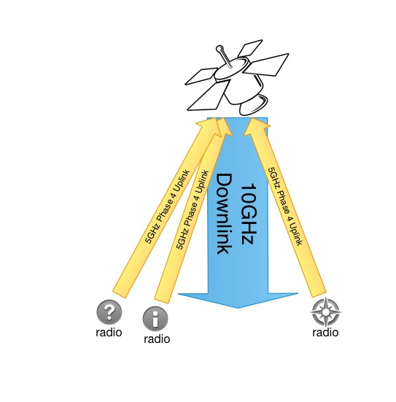
Phase 4 radios

Slide 6
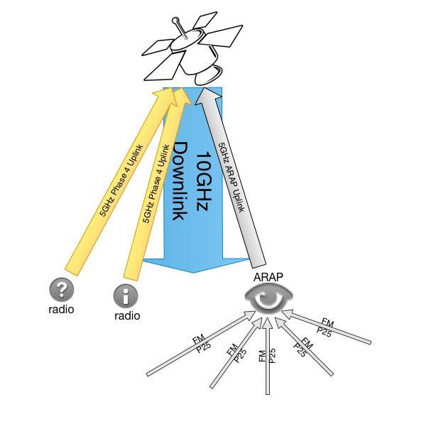
Phase 4 radios
ARAP

Slide 7
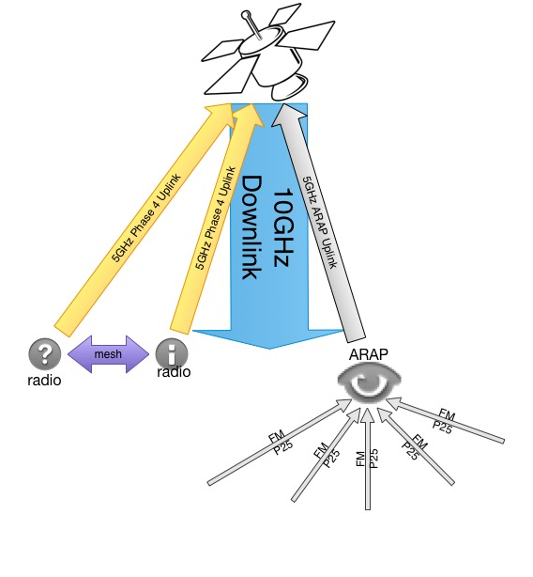
Phase 4 radios
meshed
ARAP

Slide 8



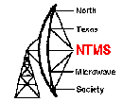
Who else is directly supporting this project?
Palomar Amateur Radio Club, Escondido Amateur Radio Society, Dixon Lake Recreation Area, North Texas Microwave Society, Federal Emergency Management Agency, Amateur Radio Relay League…
Notes:
There’s a lot of support

Slide 9
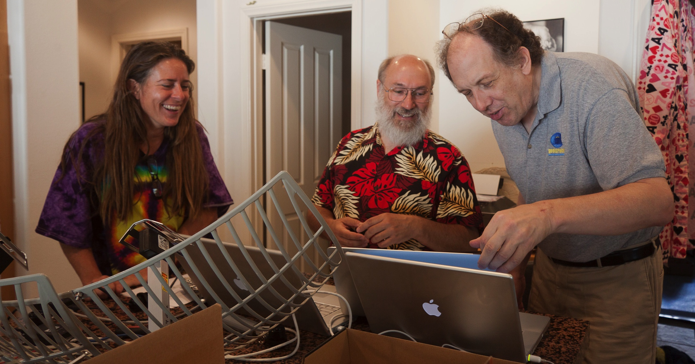
And lots of volunteers!

Slide 10
Current Status
We have a growing team of 40 volunteers/employees
A $100,000+ rideshare payload study at MSS is underway
We are expecting a late 2016 or early 2017 launch
We will have 100 watts of power from the spacecraft
We will enjoy access to the coldplate
We can use several external areas on the spacecraft for antennas
We do not have to control the spacecraft
Ground station development is completely open source
Space segment development is ITAR controlled
Notes:
35 volunteers from across the US and Canada
The study at Millennium Space Systems is to make sure that the amateur radio payload will not interfere in any way with the primary mission, and to confirm what spacecraft resources we will have access to.

Slide 11
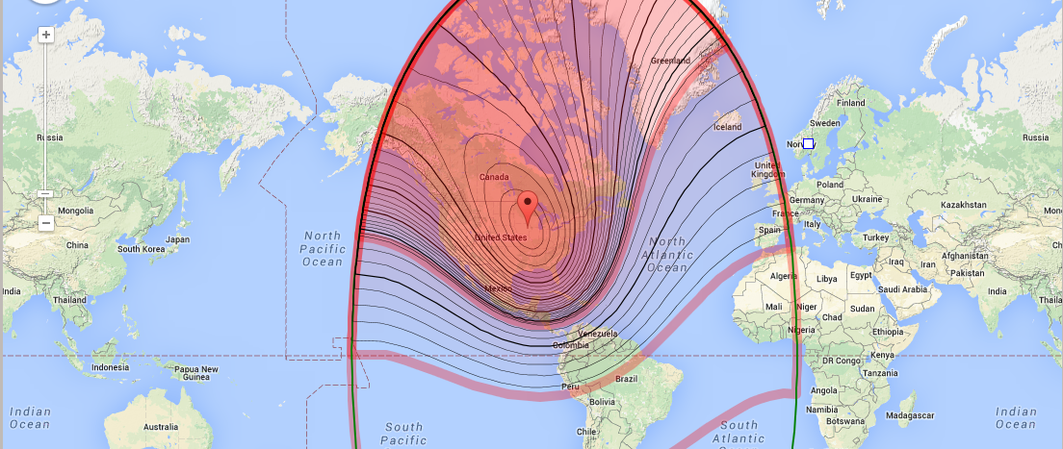
Possible Satellite Footprint – 74 W

Slide 12
Wide Field of View Connections
WFOV
MSS
Air Force
Jeff Ward K8KA
Col Fred Kennedy
University of Surrey
University of Surrey
AMSAT
TAPR

Slide 13
Issues and Resolutions
International Traffic in Arms Regulations directly affects this project
What and how did it impact the project?
Time wasted, stress increased, harsh and unnecessary limits on human resources
Splitting up the project into Ground and Space allowed for open source development of the ground station while enabling the space segment development to continue to comply with ITAR.
Teams are now separate and communicate through the Air Interface Document, which defines the radio link between satellite and stations on the ground.
Notes:
ITAR (International Traffic in Arms Regulations) and the EAR (Export Administration Regulations) are export control regulations run by different departments of the US Government. Both of them are designed to help ensure that defense related technology does not get into the wrong hands. Satellites are a controlled technology.

Slide 14

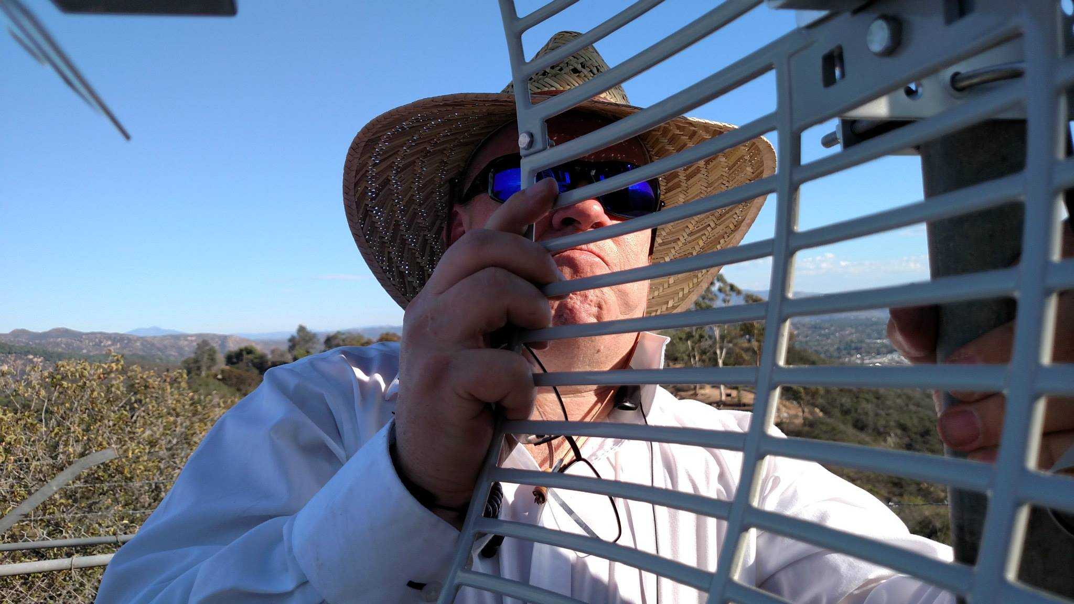
Phase 4 Top-level Team Structure
Common Air Interface
Phase 4 Ground Team
Phase 4 Space Team
https://github.com/phase4ground
Notes:
United through github!

Slide 15

Phase 4 Ground Team Structure

Slide 16
It’s All About The Team
RF Hardware
5GHz link
Applications
QSO party
Digital Hardware
USRP prototyping
Host spec
Mesh radio interface
10GHz link
Antennas
SatChat 1k
Servers
Xmpp
YAWS
Authentication
EmComm
Stereo Field
FractalQSL

Slide 17
Phase 4 Ground Leadership Supports the Team
helps
Michelle W5NYV
Ground Team Lead
helps
Bill Reed
AMSAT Project Manager
helps
Jerry
AMSAT VPE
helps…
Bob N4HY
Director of Research at Hume Center VT

Slide 18
Development System
Groundsat
ARAP
User Terminals

Slide 19

Groundsat

Slide 20
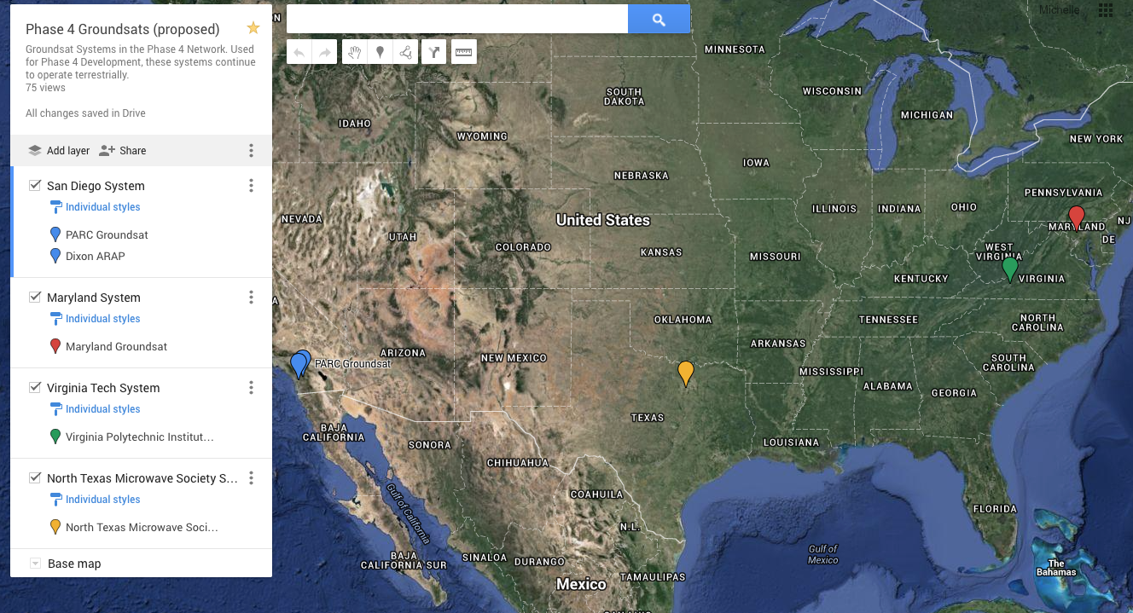
Groundsat sites are planned in four US locations with a variety of weather and geography.

Slide 21
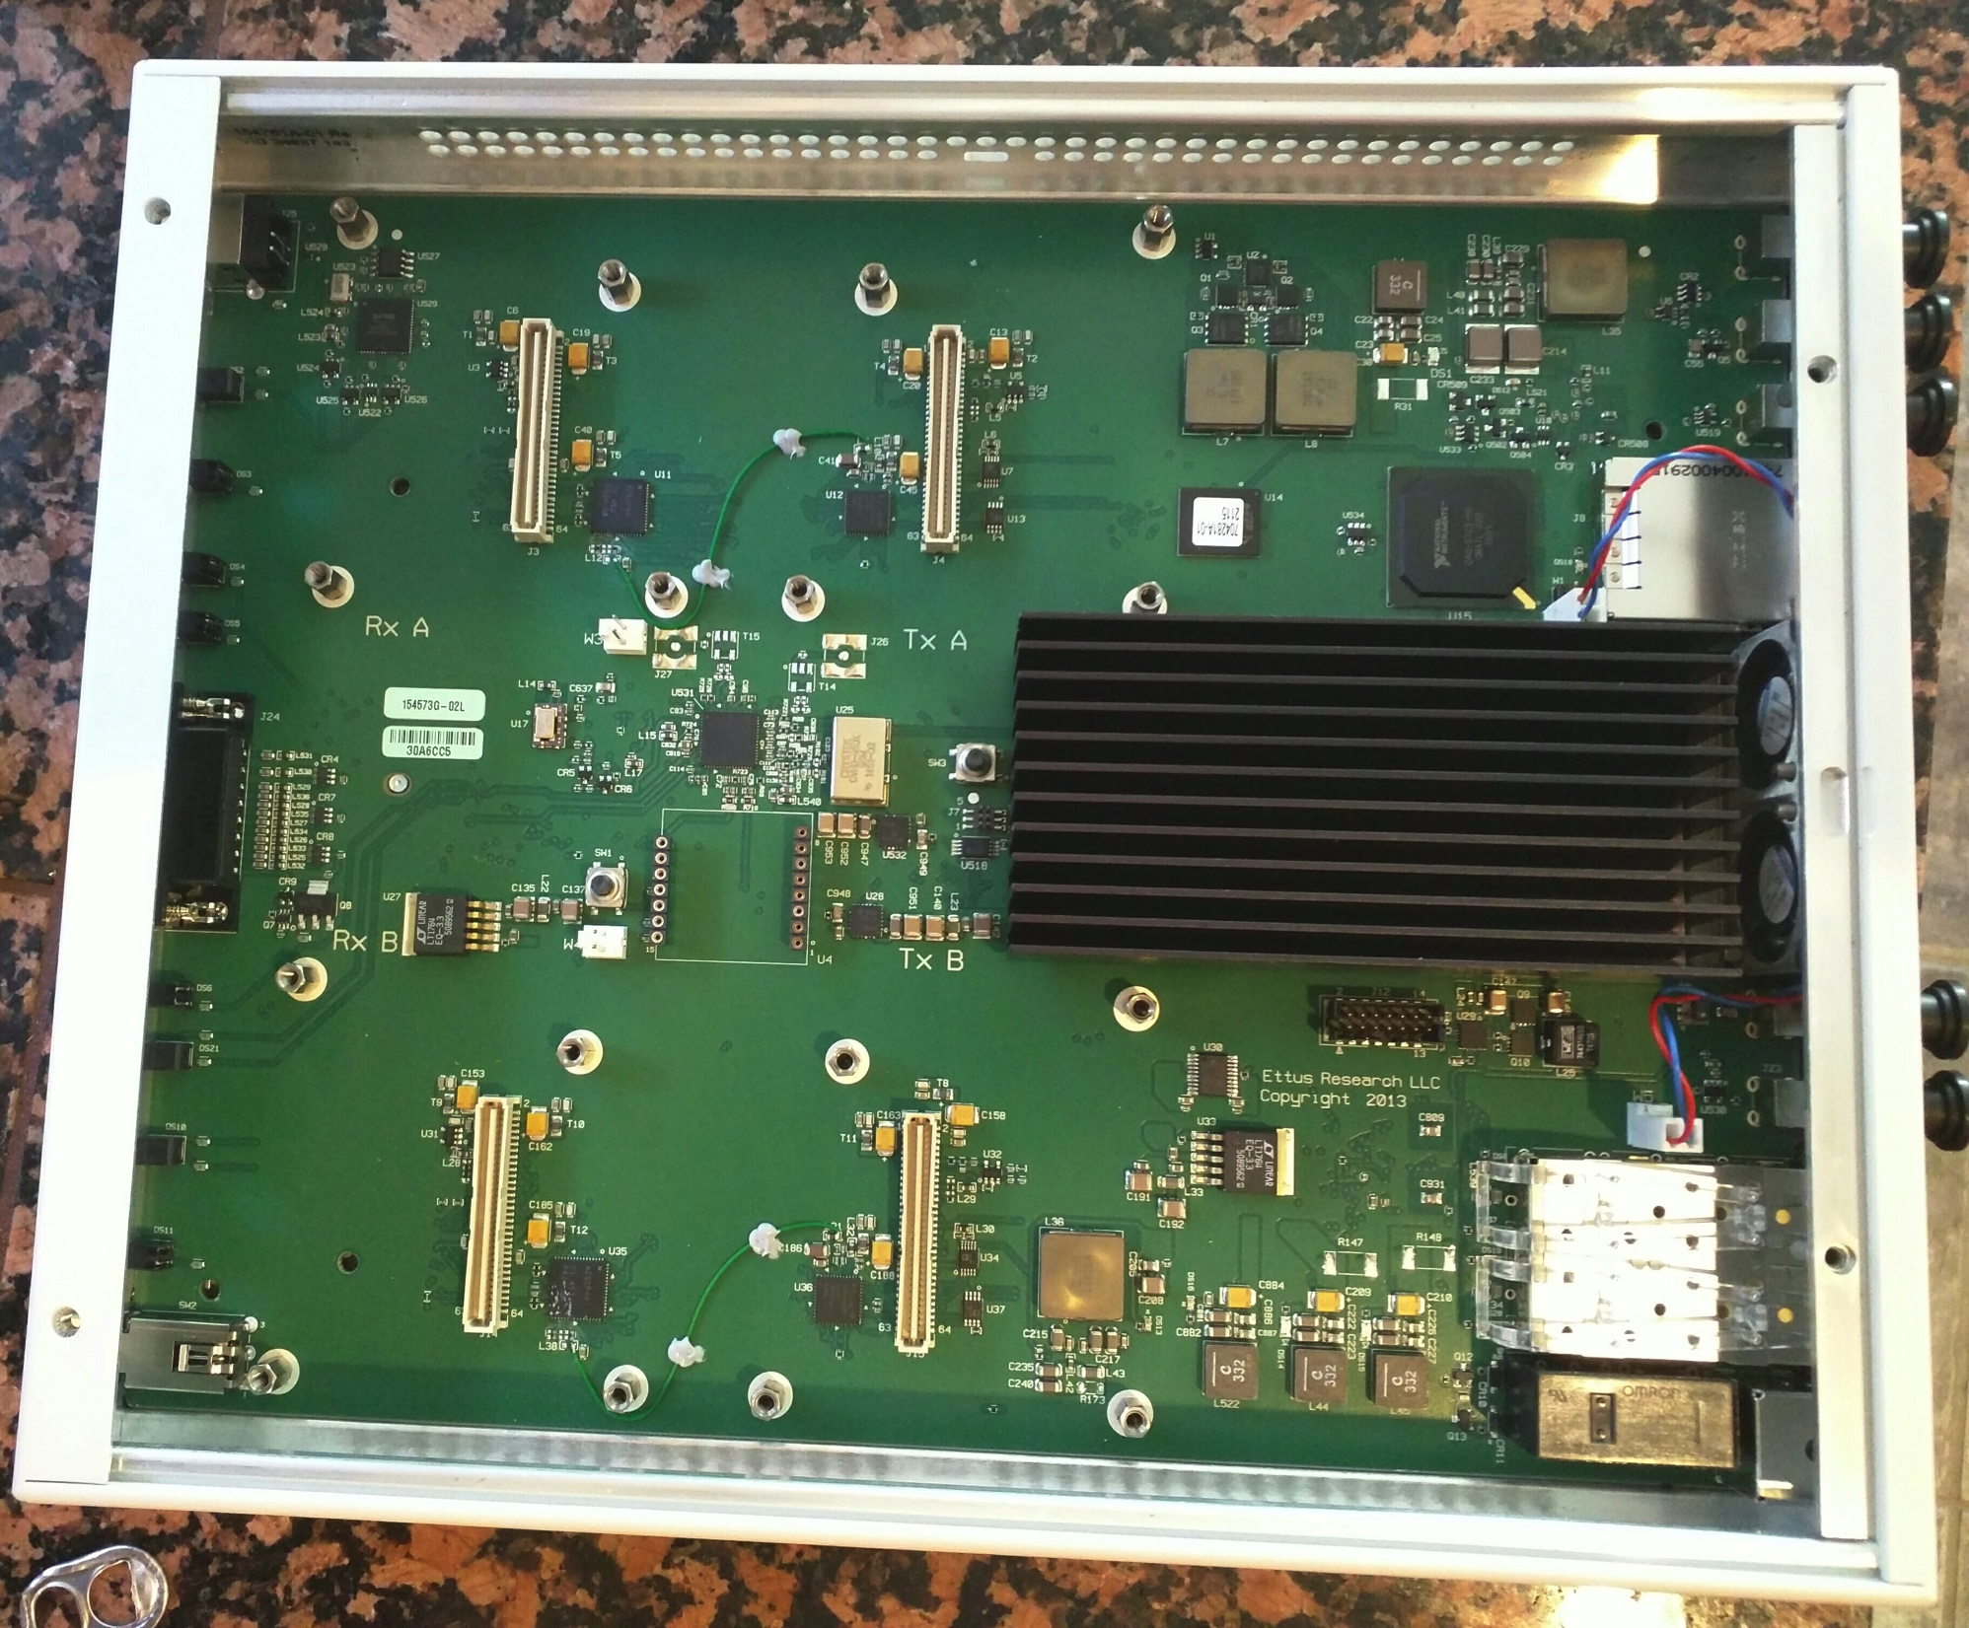
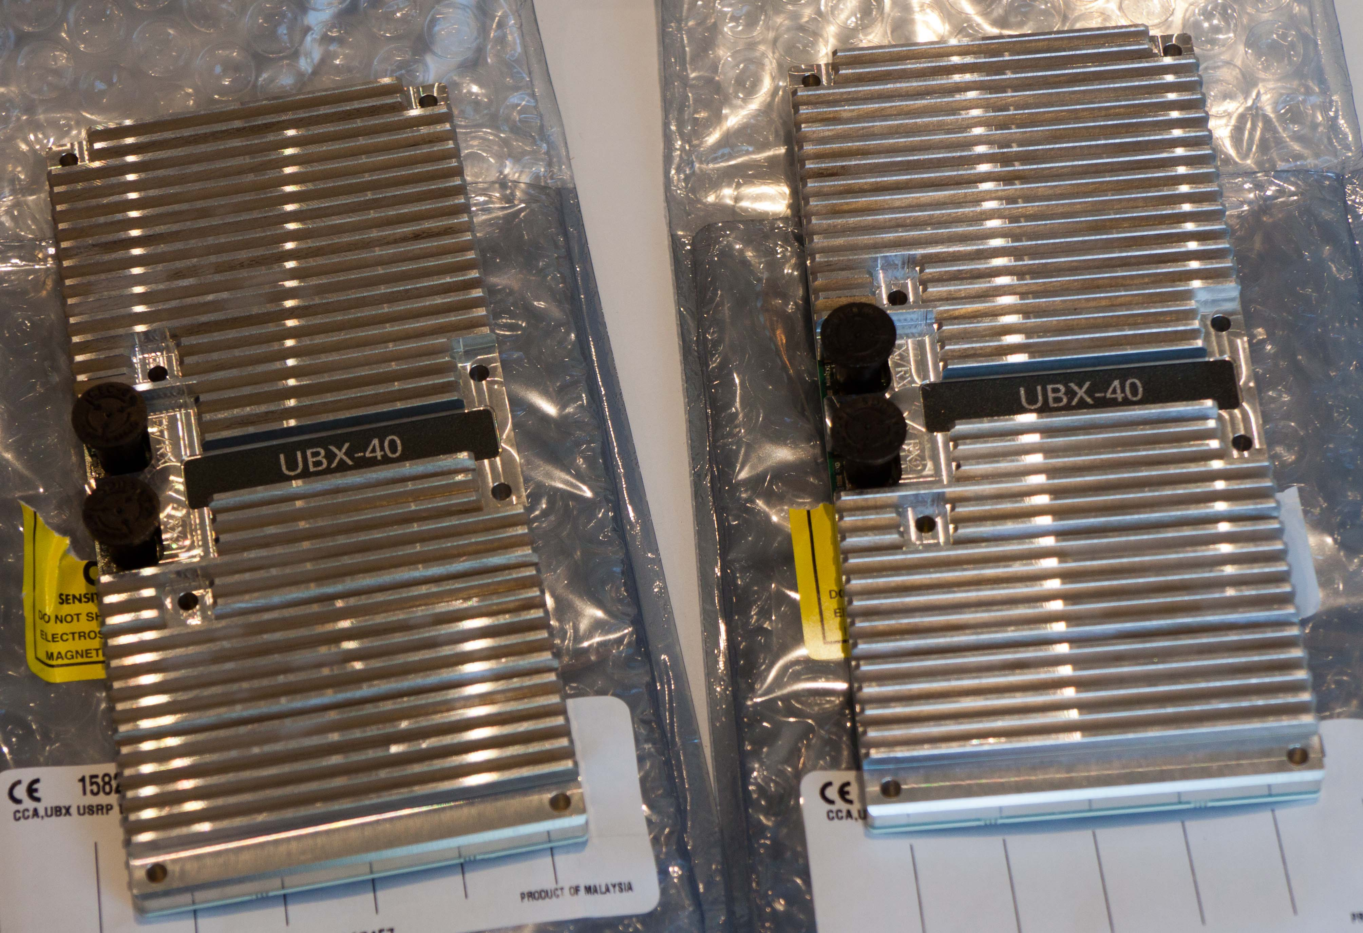
USRP* X310 and 10MHz – 6GHz RF daughter cards. This will simulate the FDMA demodulator and TDM modulator functions provided by the satellite.
*Universal Software Radio Peripheral

Slide 22
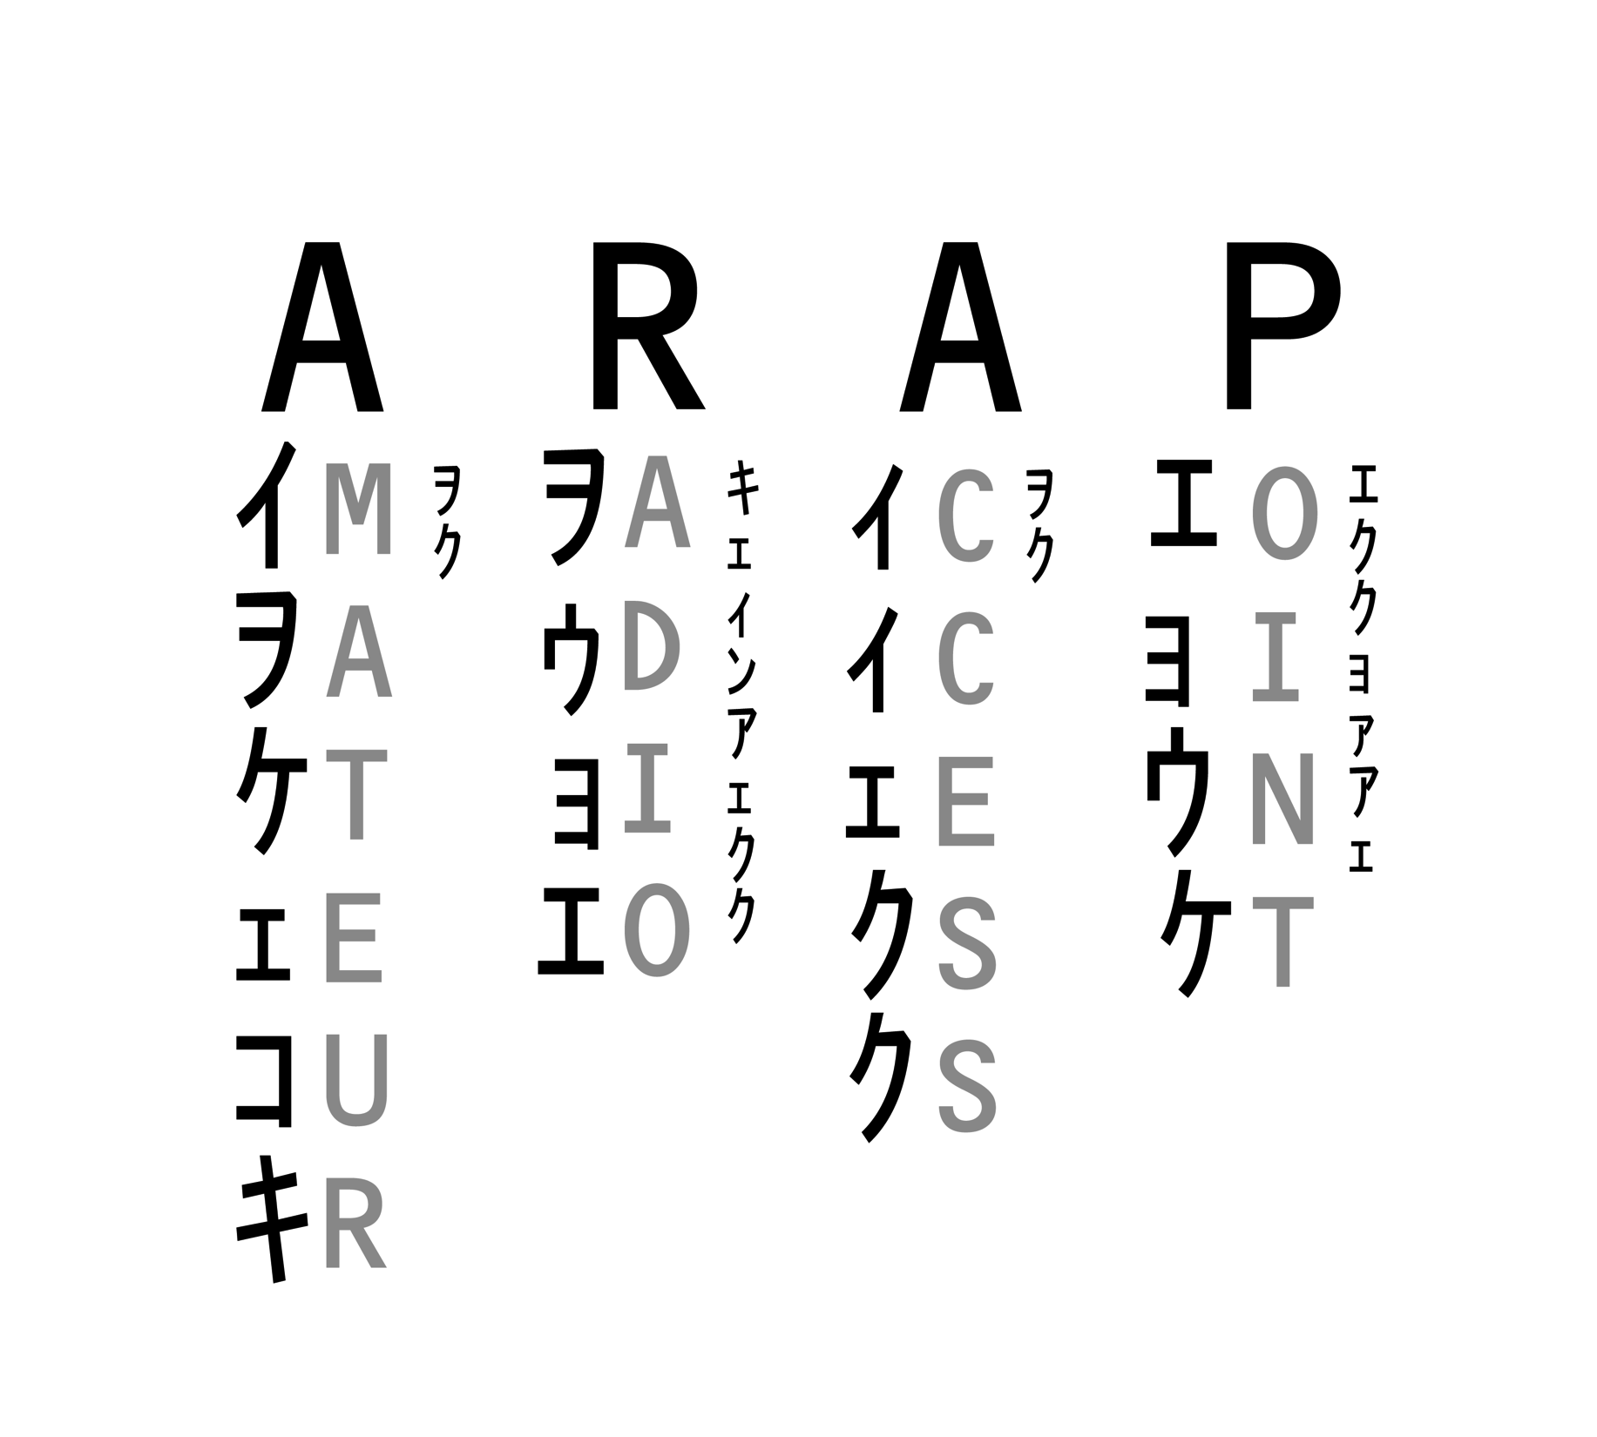

Slide 23
Amateur Radio Access Points
Amateur Radio Access Points (ARAPs) aggregate radio traffic and send it to the satellite. They are powerful mobile stations that can provide emergency communications out of an affected area to either a satellite or Groundsat.
The goal is for emergency or credentialed personnel to use their own radio gear.
During a communications emergency, shared secrets allow for control of access to the satellite uplink.

Slide 24
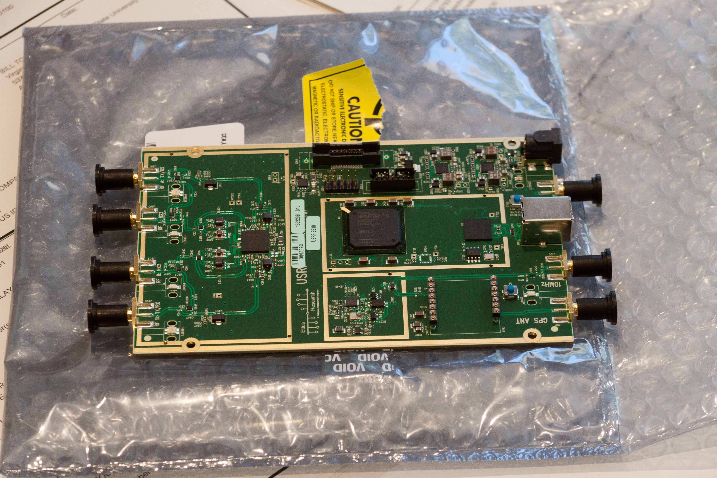
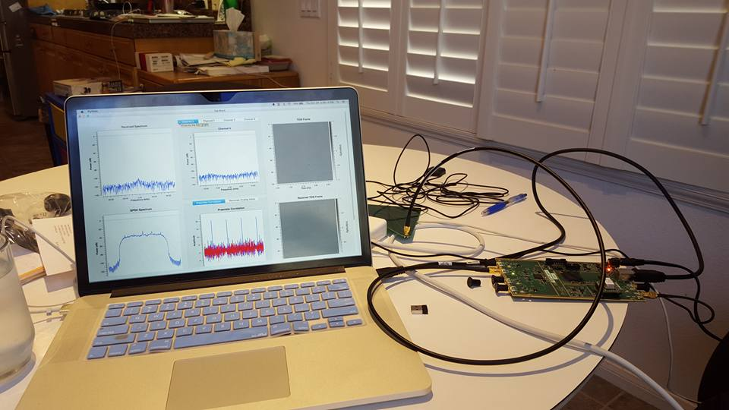
USRP B210 set up to demonstrate an ARAP collecting local FM traffic.
First demonstration was made at the AMSAT Symposium on 18 October 2015.

Slide 25
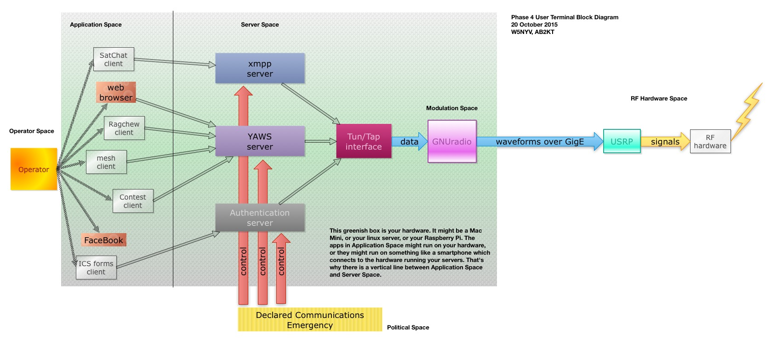
User Terminals… are still a block diagram

Slide 26
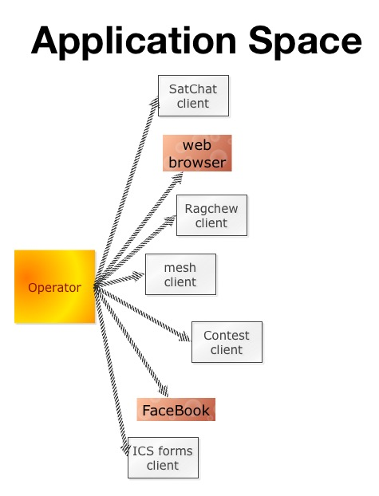
But, we have a great block diagram that has survived its first review.

Slide 27
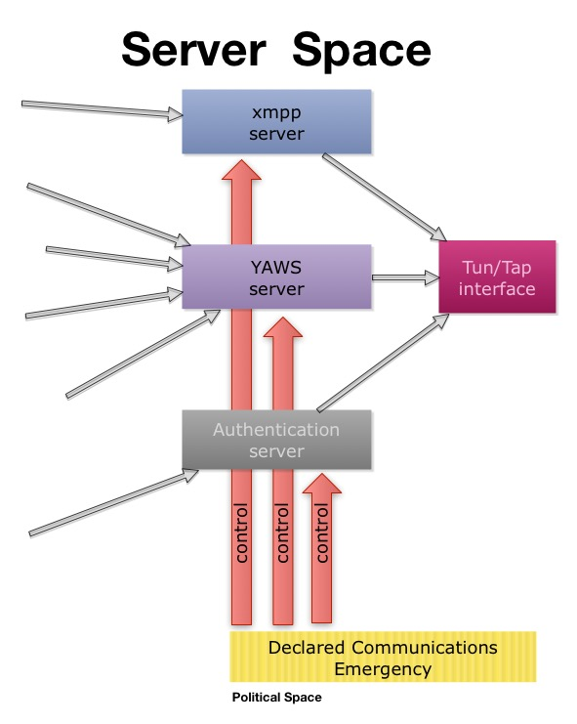

Slide 28
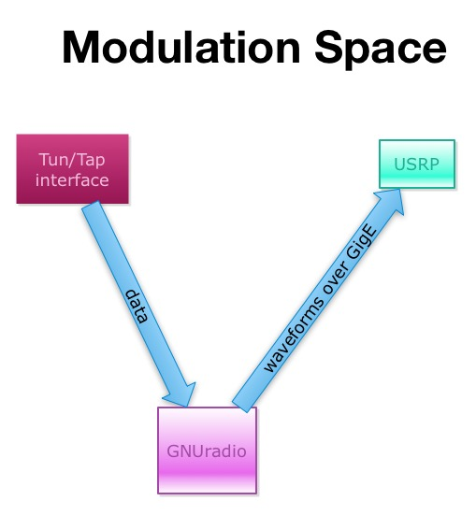

Slide 29
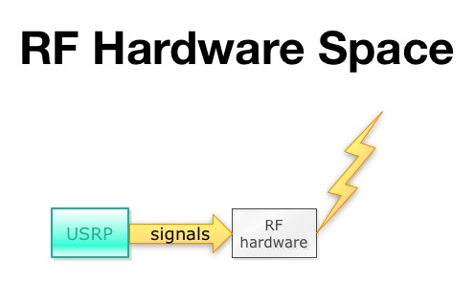

Slide 30
Contact Phase 4 Ground
https://github.com/phase4ground (team of 15 not visible)
phase4@amsat.org (apply for membership to this address, open to both US and non-US citizens)
Contact Michelle w5nyv@yahoo.com for more information.
Contact Phase 4 Space
Due to ITAR, both the repository and the mailing list are closed, invite-only, and restricted to US citizens only.
Contact Jerry Buxton vpe@amsat.org for more information.

Slide 31


